Slide 1



Mani Madhuri Manthina
SmartSchedule: An app to help auto-schedule hangouts and trips with friends
Landing Page

Slide 2


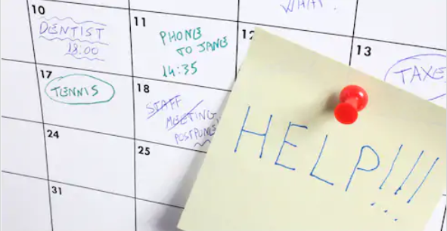




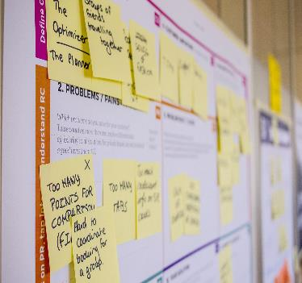


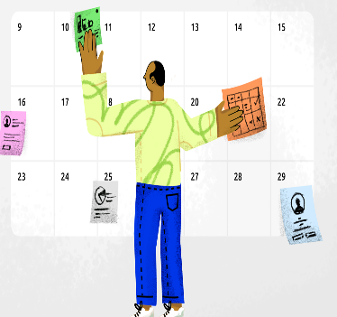

Customer Hypothesis
Busy young professionals in LA find it difficult to coordinate hangouts and trips with friends

Slide 3




Description
Validated
Customer
Persona
Men and Women
Aged 25 to 45
Working in full time jobs and busy schedules
Live in Los Angeles
Behaviors
Busy most of the week
Got at least 5 hours of free time for friends
Enjoy spending time with friends
Spend more than an hour planning for hangouts
Miss hangouts due to conflicting schedules or sometimes due to forgetting about them
Needs and goals
Want an easy and time efficient solution to plan for trips or hangouts with friends
Want a solution that could help them easily match free time with friends
Do not want to miss hangouts or trips with friends

Slide 4

Findings: Hypothesis Validated
mentioned that they spend more than 90mins on an average to make plans
70%
mentioned reasons such as ‘not able to schedule’ or ‘conflicts’ as their reasons for avoiding trips and hangouts.
70%
mentioned that they missed hangouts more than 5 times over the last year
60%
Results of 6 Men and 4 Women aged between 25-45, working full-time in LA.
interested in an app that could help with scheduling hangouts and trips
80%
2 women mentioned phone calls and group chats to be easier options to be able to discuss things in detail. Most were interested in free and easy-to-use options

Slide 5


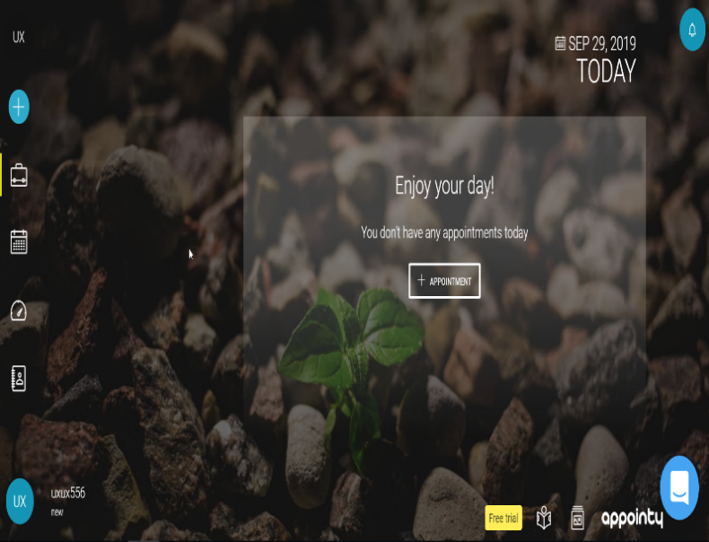

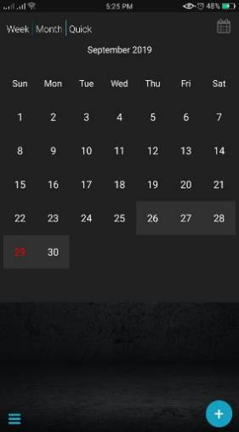
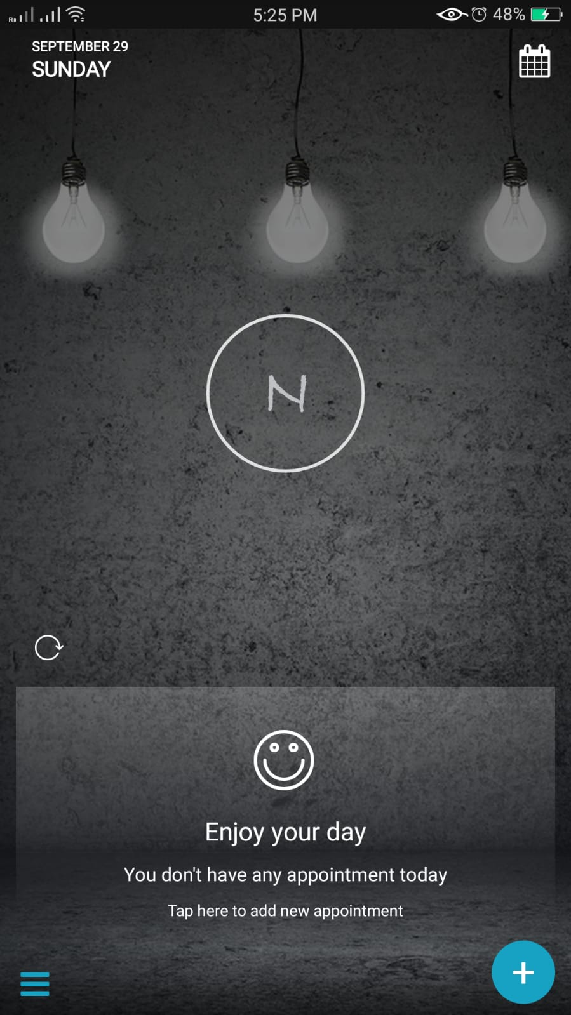
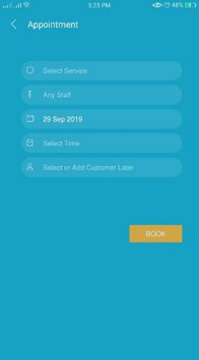

Direct Competitor: Appointy
Description
Appointy is all-in-one online scheduling software. Its simple, functional, yet powerful user interface makes it easier and improves productivity. The software allows practical self-scheduling at any time.
Pros
UI is easy, comfortable and pretty
Has self-scheduling capabilities
Offers options for group scheduling based on free schedules
Cons
Higher monthly subscription costs
Useful only to schedule business meetings

Slide 6



Marketplace Analysis September 2019
Current Marketplace
Opportunities
Recommendations
There are a sensible number of products out there that offer highlights such as auto-scheduling capabilities, group chats, travel organizers and advisers, but nearly none that effectively consolidates all of the features. A few of them have evolved recently and have included the AI capabilities. The closest competitor to our value proposition,
Appointy focuses at the viewpoint of auto-scheduling powered by AI but not equipped toward offering travel planning comforts.
The value proposition proposed aims to combine features of auto-scheduling, group chats and group planning, proposes travel ideas and all using AI to capture free schedules.
Given the reality that the current market does not offer all of these highlights in a single stage, there's a better plausibility of our value proposition taking life and surviving superior. Also most of the apps offer restricted services in free versions and don't have mobile apps but only a website .
Our value proposition aims to offer services free of cost, considering financing from other sources.
App can also be integrated with other favorite platforms and applications such as google or apple calendars and Facebook.

Slide 7

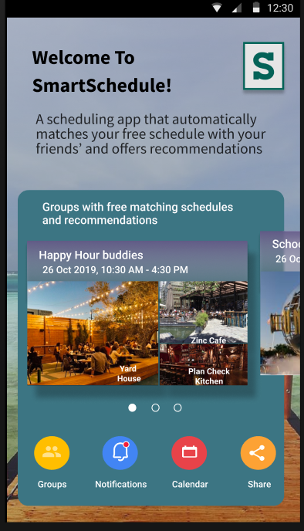
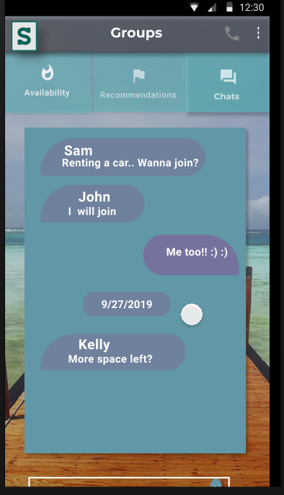
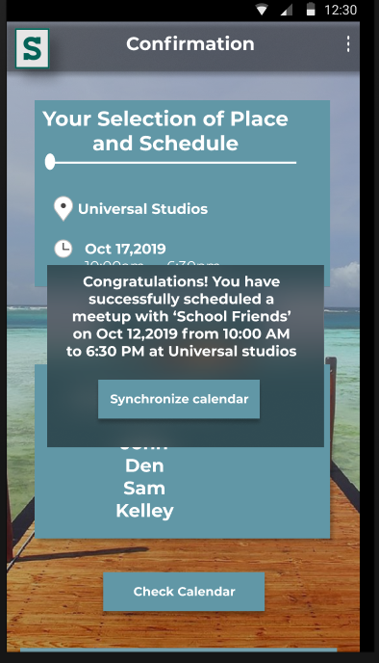
Solution Prototype
1
2
3

Slide 8



Key Experiences
Auto-scheduling
Group conversations
AI feature integrates calendars of users in respective groups and offers suggestions about free schedules
Users of respective groups can chat and discuss about the hangouts or trip plans
Recommendations
Based on past plans, the app suggests user groups with possible options on where they could hang-out or travel. Also advices on choosing travel locations

Slide 9


Recruitment Strategy
f
Craiglist
Facebook
Friends of Friends
Post recruitment Ads on Craiglist guest member section for people who love to hangout with friends.
Post a recruitment Ads in Los-Angeles based meetup groups available on Facebook
Ask friends to refer people they know, to participate in research
$$$
Compensation
Participants will be compensated with a $20 Amazon gift card.

Slide 10
Guerrilla User Research Study Findings Brief
Persevere
100%
80%
80%
Problem
Hypothesis
Value Proposition
Business
Model
Problem Hypothesis
Value Proposition
Business Model
All the interviewees said that they had issues with scheduling and utilized the existing time-taking resources such as calls and chats to schedule hangouts and travel plans
Some of the participants mentioned that calls are still useful. However, most participants agreed that they had difficulties with existing sources and wanted better and automated solution
Advertising via scrolling or videos that typically pop up before confirming or during choosing from recommendations and notifications. Most participants agreed to the proposed business model

Slide 11
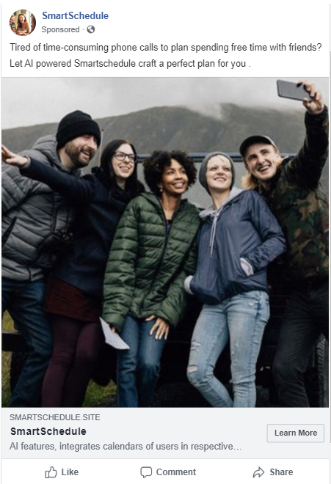
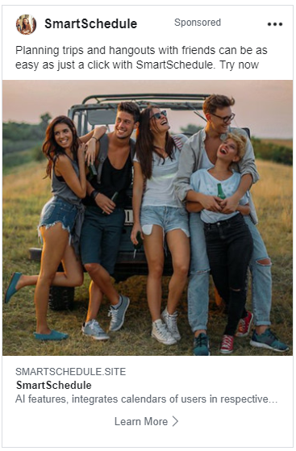
Advertisement Campaign
Facebook Ad 1
Facebook Ad 2
1
2

Slide 12




Unbounce Landing Page Middle

Slide 13

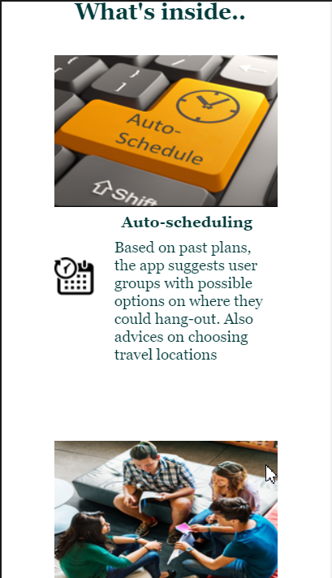
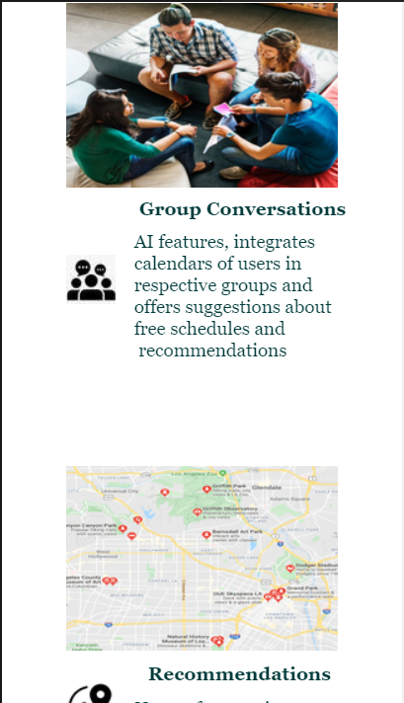
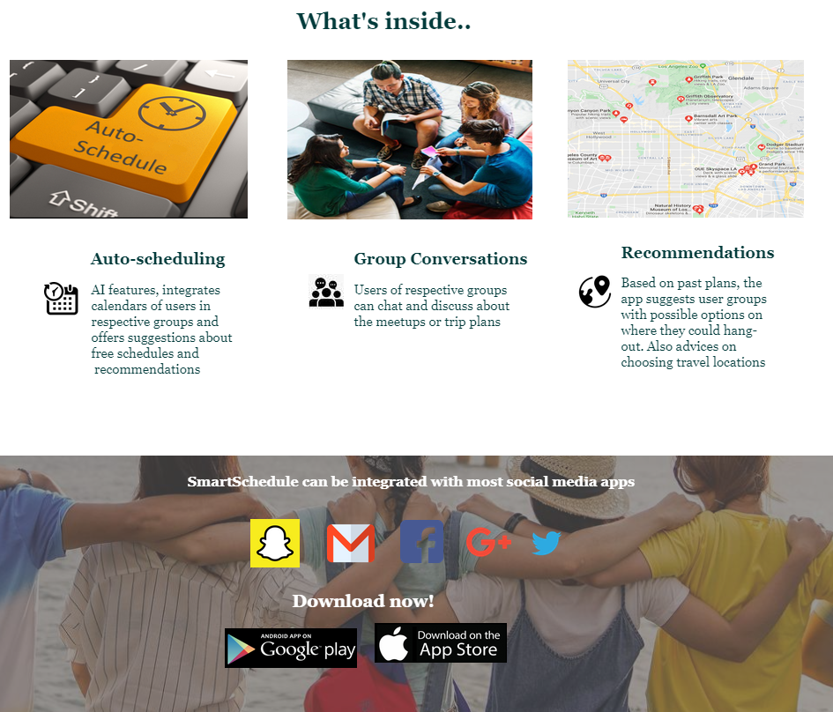
Unbounce Landing Page Middle

Slide 14
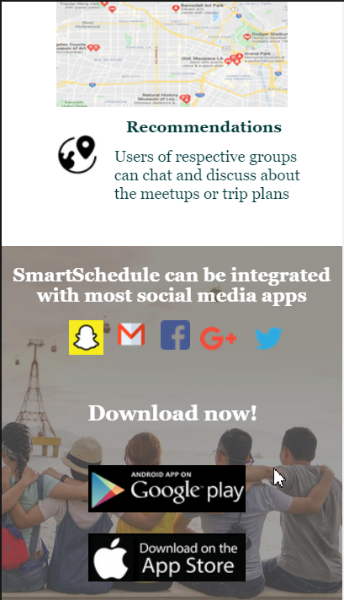
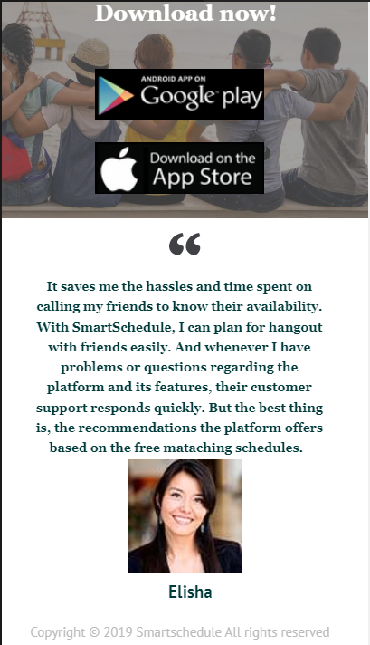
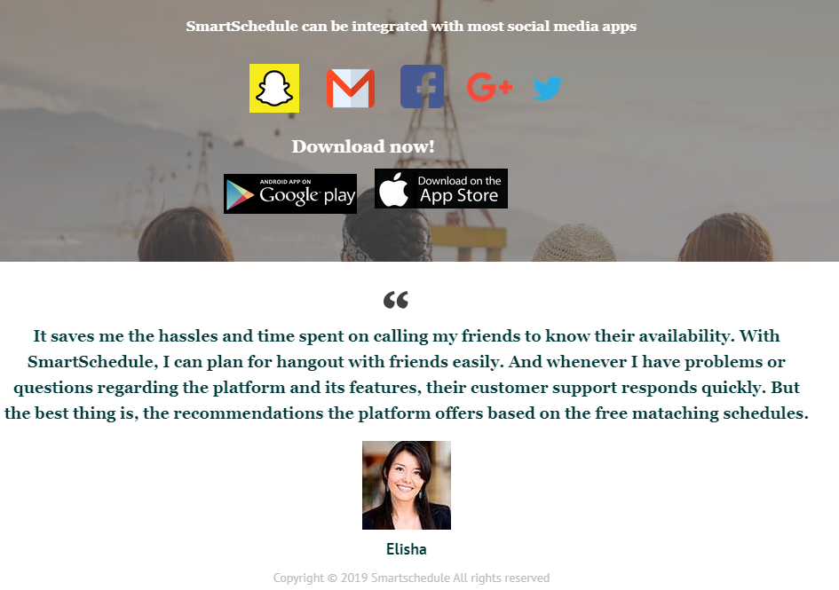
Unbounce Landing Page Bottom

Slide 15

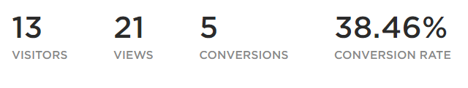
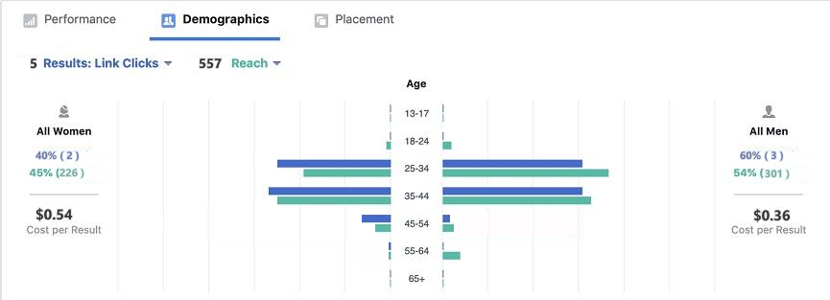

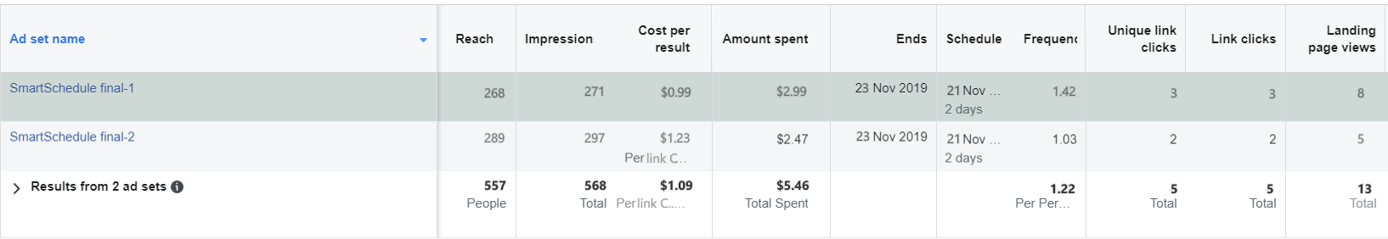
Findings And Conclusions
Target group
Majority of the target audience are men
Target audience fall under the age group of 25-45
Performance
The ads reached around 557 audience and created 564 impressions
Used high resolution and realistic images along with a better caption and this change resulted in an improved conversion rate of more than 30%
There is a considerable improvement in the number of clicks from previous runs and the ad campaign was successful

Slide 16
Aug-2020
Deployment and improvement through user data analysis
$120000
Sep-2020
Marketing
$200000
Jul-2020
Testing
$180000
20
18
12
May-2020
Development
$250000
25
Feb-2020
Wireframing and technical feasibility assessment
$100000
Budget Roadmap
10
15
Total Allocated Budget : $1,000,000
Jan-2020
Research and planning
$150000

Slide 17


